Slide 1
Fire Modelling of Energy-Efficient Apartment Buildings – Consideration of air-tightness and mechanical ventilation
Simo Hostikka
Aalto University, Finland
Fire and Evacuation Modelling Technical Conference (FEMTC) 2016

Slide 2
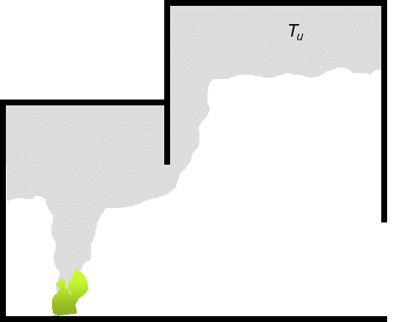
Background

Slide 3







The project
Partners
Aalto University
Stravent Oy
Southwest Finland Rescue Service
Markku Kauriala Oy
VTT Technical Research Centre of Finland Ltd.
Sponsors
Finnish Fire Protection Fund
Hagab AB
Criminal Sactions Agency
Ministry of Environment
Thanks to
Rahul Kallada Janardhan
Umar Riaz
Topi Sikanen (VTT)

Slide 4
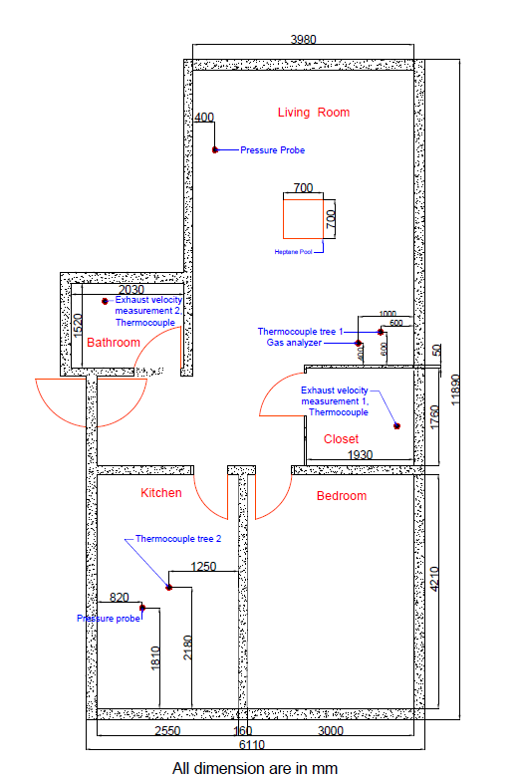
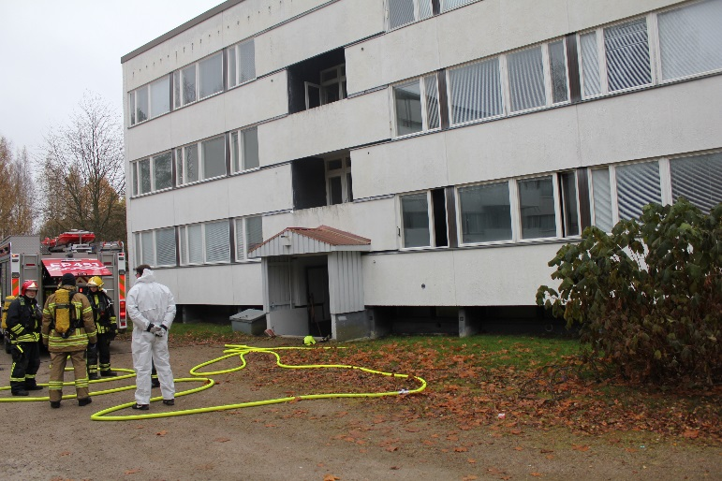
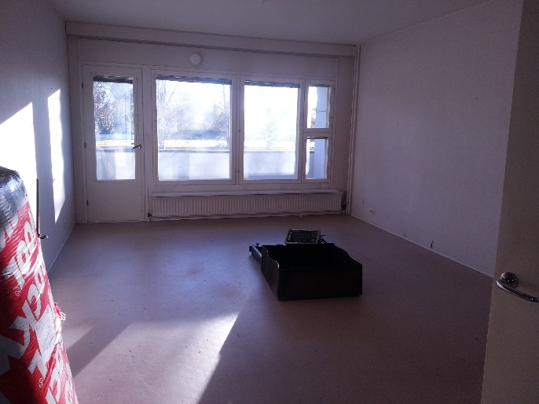
Fire experiments
3-storey apartment building in Kurikka, western Finland
Built in 1970’s.
Windows renewed few years ago.
Tests in a 1st floor apartment
58.5 m²
https://www.youtube.com/watch?v=0Ss_ONolzLY

Slide 5
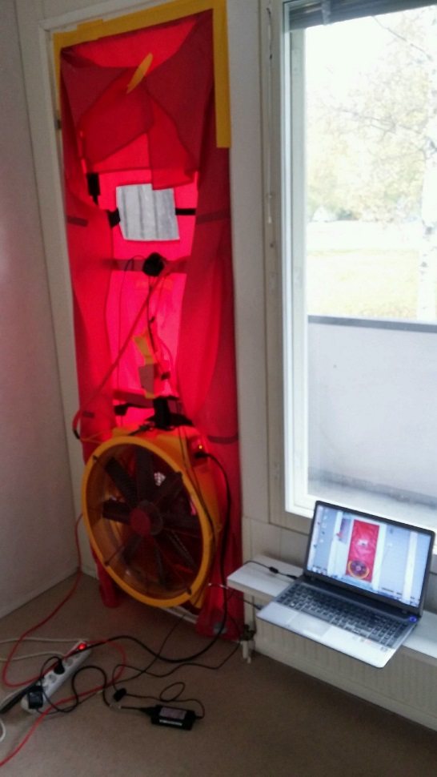
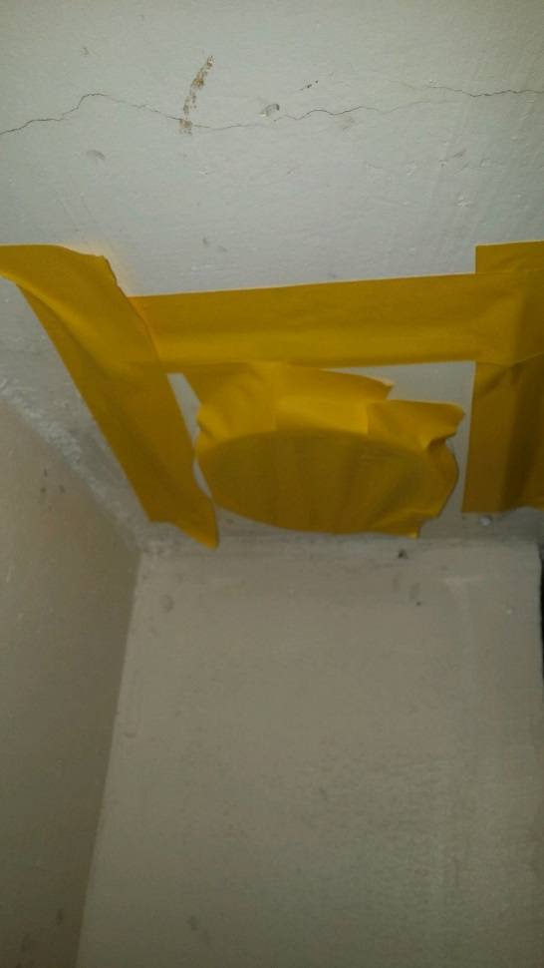
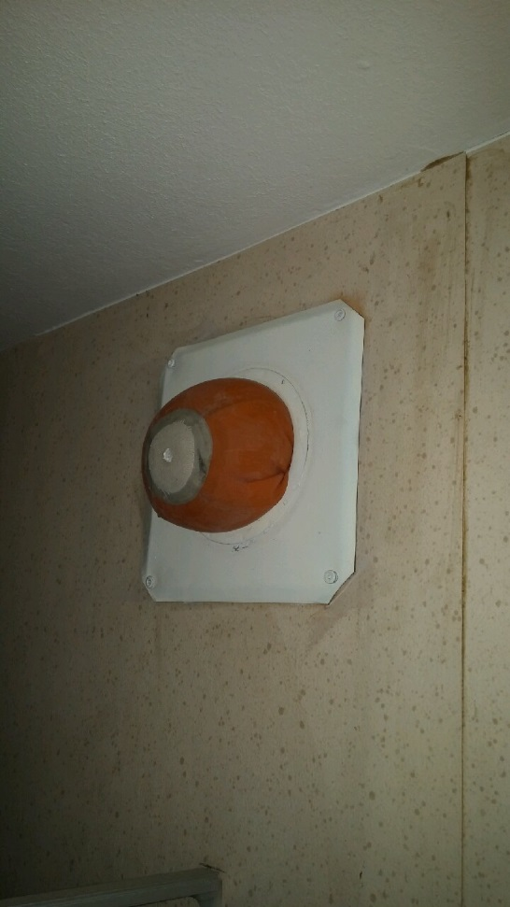
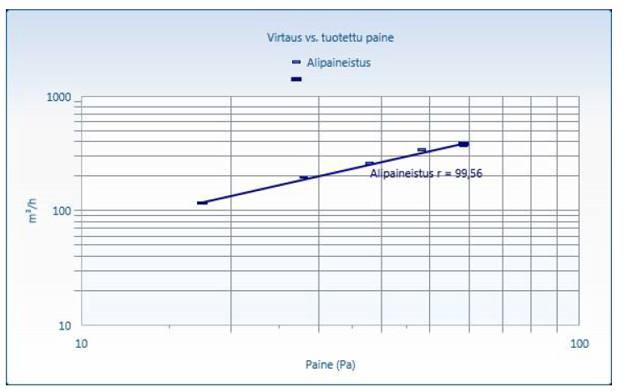
Air tightness measurements
SFS-EN 13829, Mikko Yli-Piipari / Vertia Oy

Slide 6
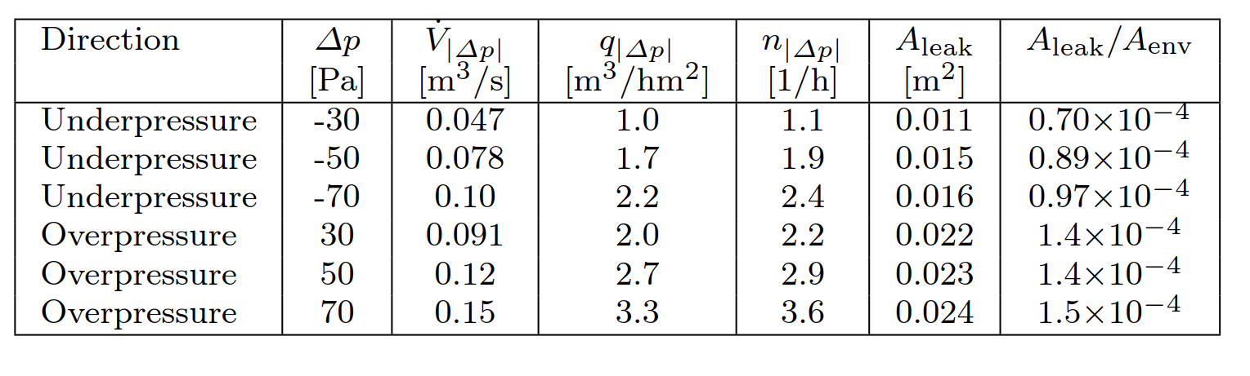
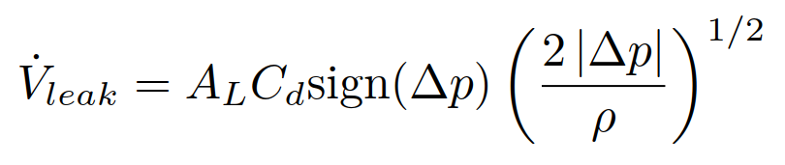
Results of the air-tightness
RakMK D3 (2012)
Requirement: q₅₀ ≤ 4 m³/hm²
Recommendation: q₅₀ ≤ 1 m³/hm²
NFPA 92 (2012):
Very loose: A_{leak}/A_{env} = 12 ×10⁻⁴
Loose: A_{leak}/A_{env} = 3.5 ×10⁻⁴
Average: A_{leak}/A_{env} = 1.7 ×10⁻⁴
Tight: A_{leak}/A_{env} = 0.50 ×10⁻⁴

Slide 7
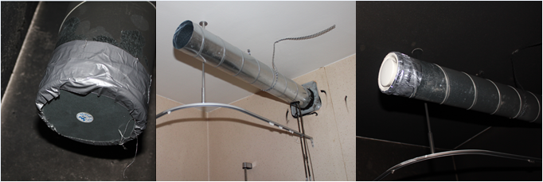
Ventilation configurations
CLOSED OPEN NORMAL

Slide 8
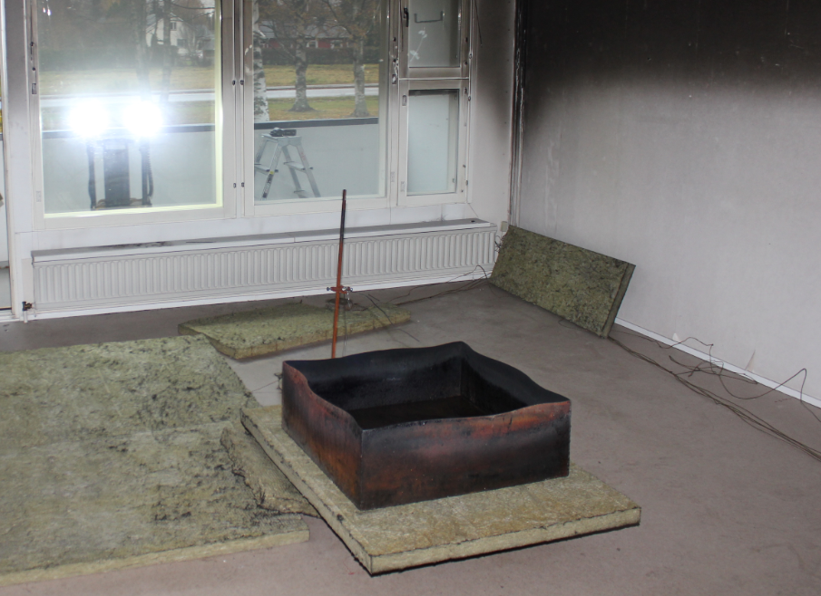
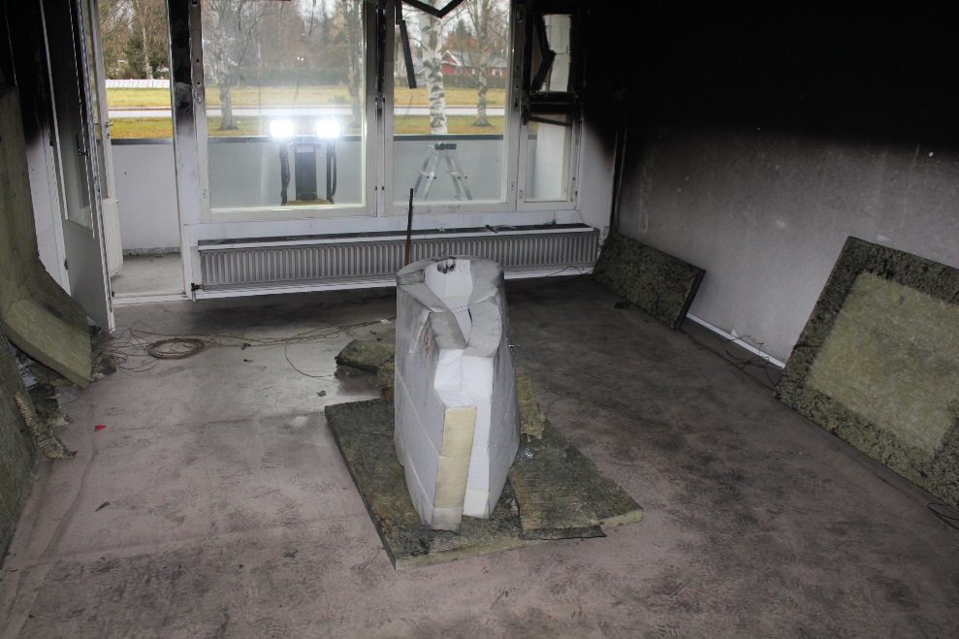
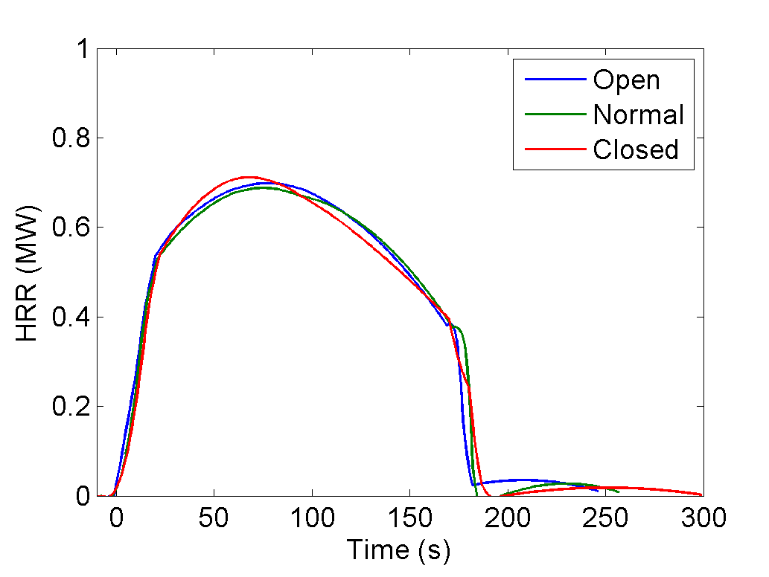
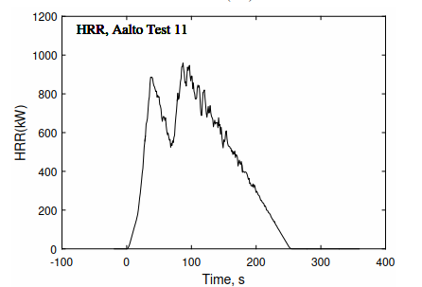
Fire loads
Group 1 (10 tests)
3 L n-heptane
0.7 m x 0.7 m pool
Group 2 (3 tests)
PUF matress of about 3 kg
Both fires were ultrafast (t_{g} < 75 s)

Slide 9
Measurements
T_{gas} (x 5)
Pressure
M_{fuel}
O₂, CO₂, CO
Exhaust
T_{gas} (x 5)
Exhaust
Pressure

Slide 10
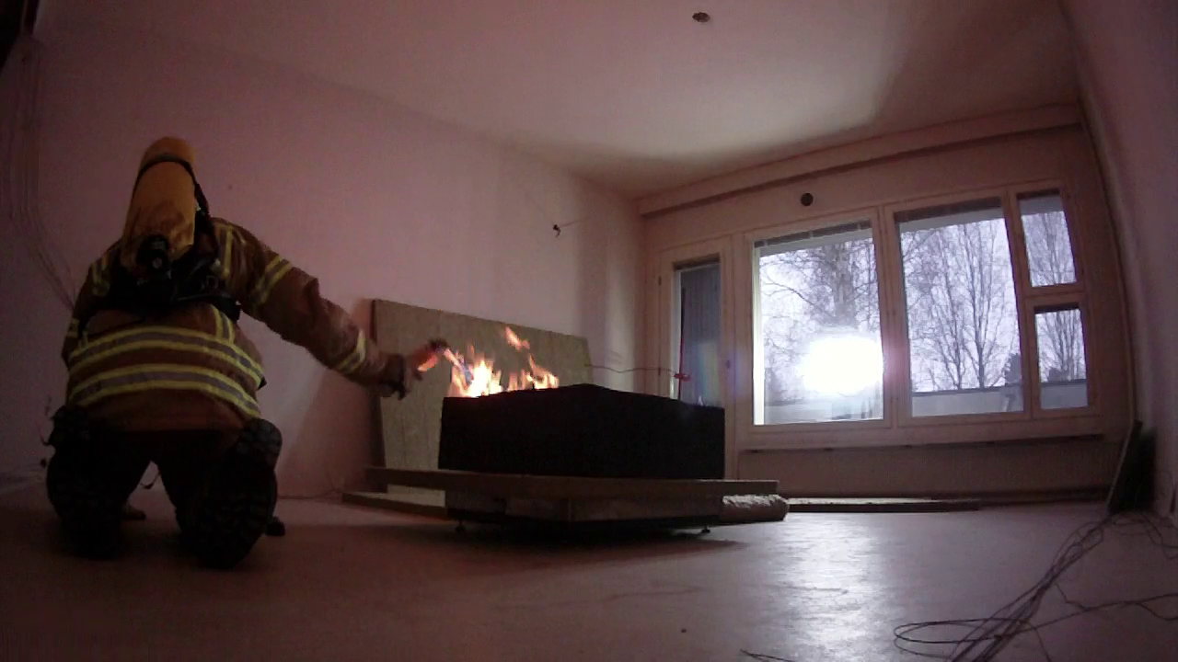
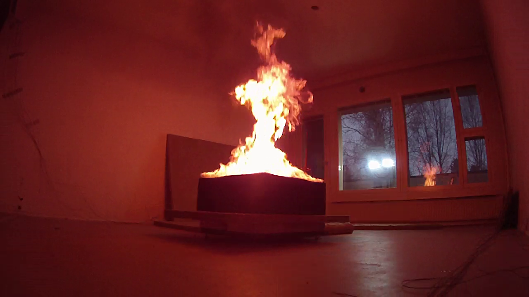
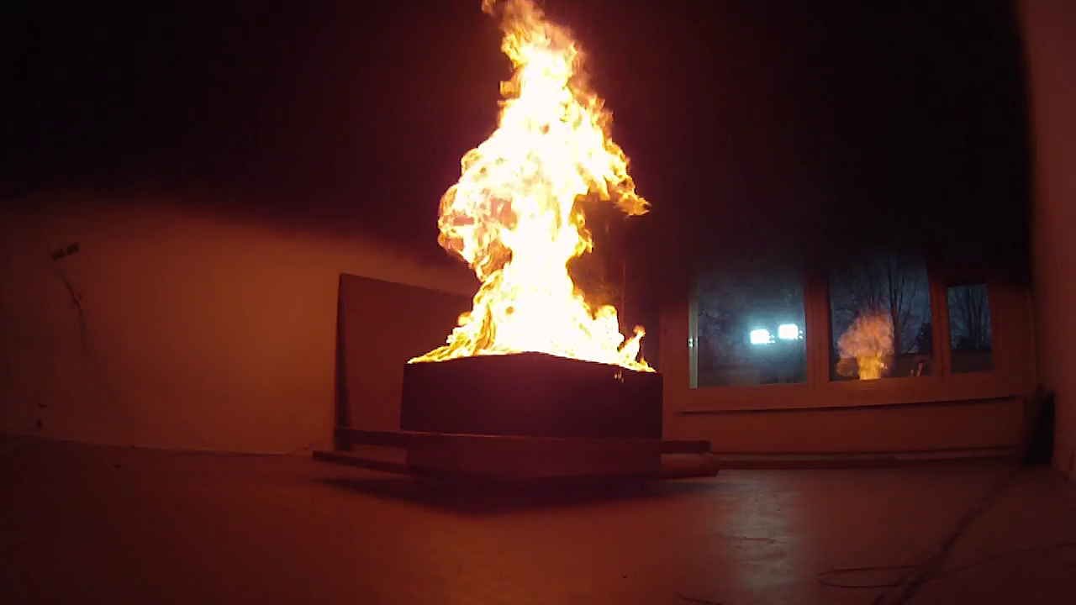
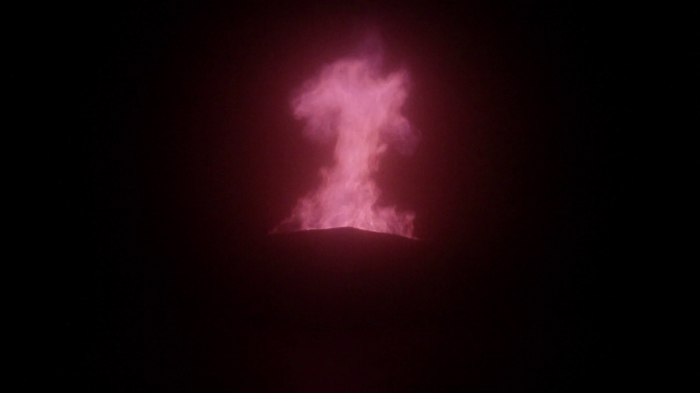

Slide 11
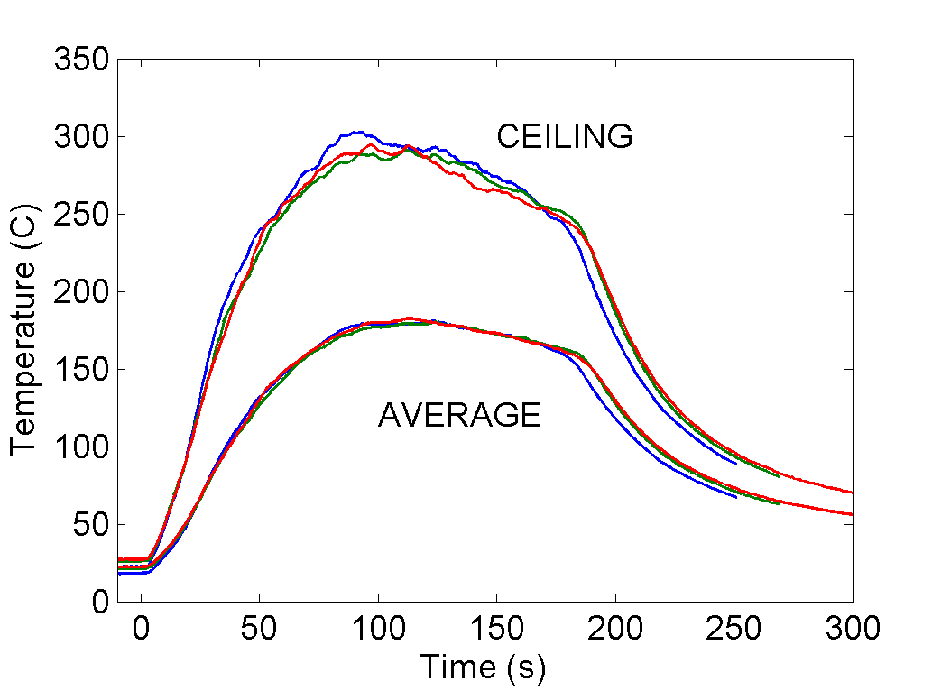
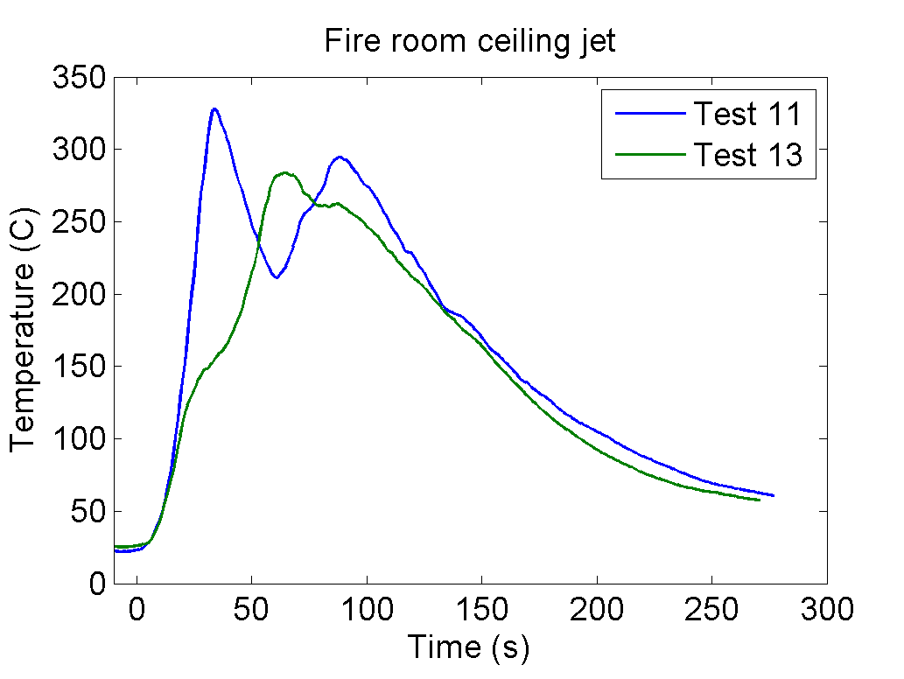
Gas temperatures
Heptane fires PUF fires

Slide 12
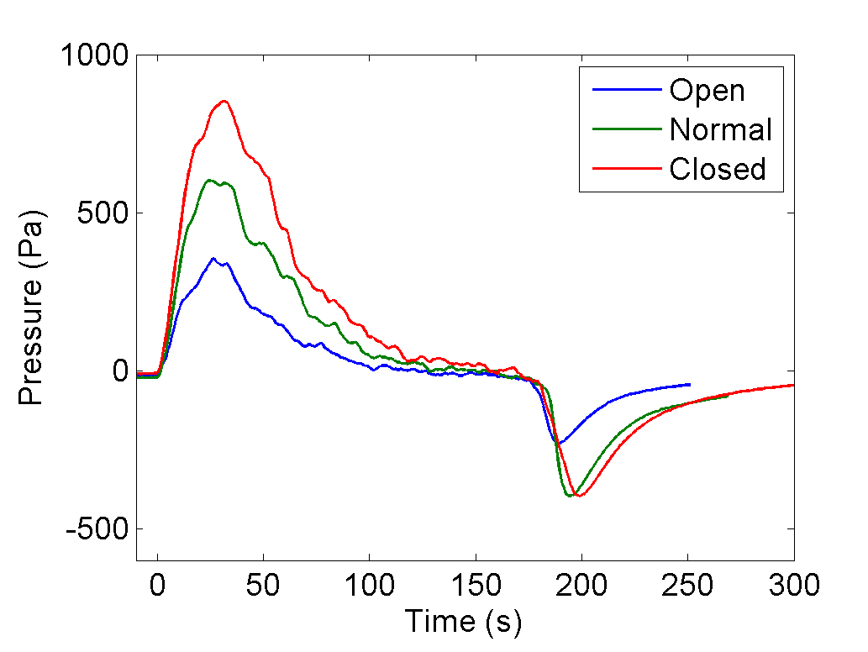
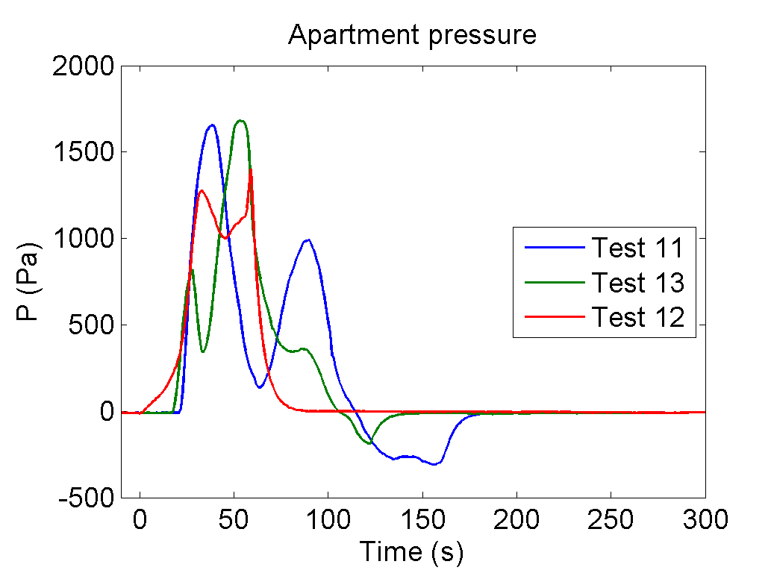
Gas pressure
Heptane fires PUF fires

Slide 13
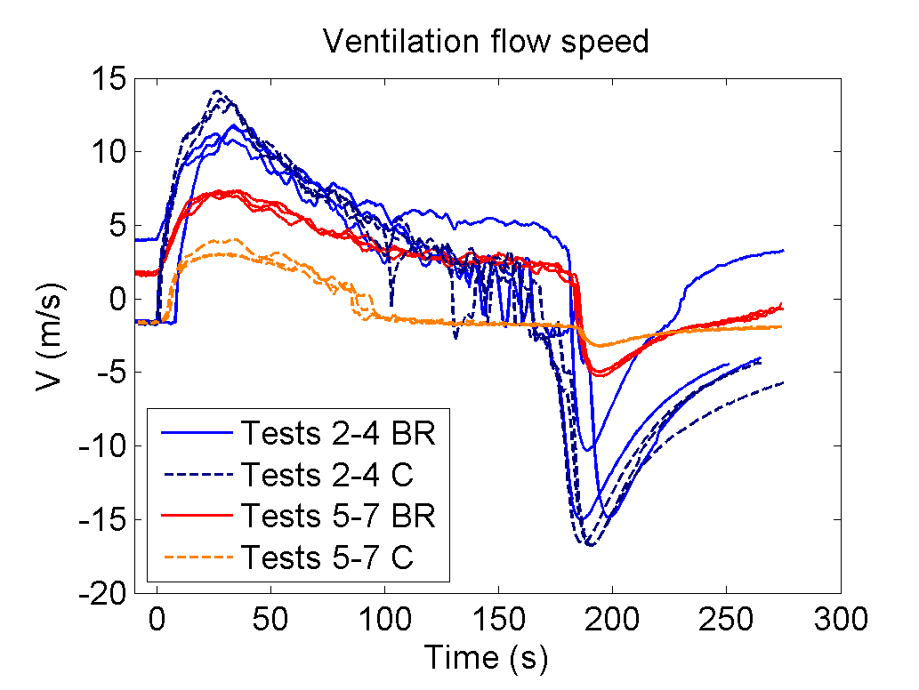
Flow speed in exhaust duct
Test 2-4: OPEN
Test 5-7: NORMAL
BR = bathroom
C = closet
Heptane pool fires

